Slide 1
Employee Data Analysis using Excel
STUDENT NAME: REVATHI V
REGISTER NO: 312200197
DEPARTMENT: Commerce
COLLEGE: South Indian Vanier Educational Trust College

Slide 2
PROJECT TITLE
Employee Performance Analysis using Excel

Slide 3


AGENDA
Problem Statement
Project Overview
End Users
Our Solution and Proposition
Dataset Description
Modelling Approach
Results and Discussion
Conclusion
3/21/2024 Annual Review

Slide 4

PROBLEM STATEMENT
Managing large datasets and complex formulas can be difficult. Combining data from various sources can be cumbersome. Metrics may not fully capture qualitative aspects of performance. Excel may struggle with very large datasets or complex analyses compared to specialized software.

Slide 5

PROJECT OVERVIEW
Automate and optimize employee performance tracking and analysis in Excel. Improve accuracy, consistency, and efficiency in performance evaluations. Enhance decision-making capabilities for talent development and resource allocation.

Slide 6

WHO ARE THE END USERS?
HR manager
Supervisor/Team leads
Business unit leaders
HR analyst
Line Managers
Employee

Slide 7

OUR SOLUTION AND ITS VALUE PROPOSITION
Our solution is a customized Excel-based employee performance analysis system that automates and streamlines the evaluation process. It provides a user-friendly dashboard for easy data entry, real-time performance tracking, and actionable insights for informed decision-making.

Slide 8
Dataset Description
The dataset contains employee performance data, including metrics, evaluations, and training records, used to analyze and evaluate employee performance. This dataset description provides a clear understanding of the variables, data types, and structure of the employee performance.

Slide 9

THE "WOW" IN OUR SOLUTION
Instantly generate performance reports with real-time data, eliminating manual errors and saving time.
Create personalized performance insights with interactive and visual dashboards. Uncover hidden trends and patterns in performance data, enabling proactive decision-making.
3/21/2024 Annual Review
9

Slide 10
MODELLING
A Strategic Modeling Approach for HR Excellence. These titles highlight the use of Excel as a key tool for employee performance analysis, emphasizing data-driven decision making, predictive analytics, and strategic HR management.
10

Slide 11
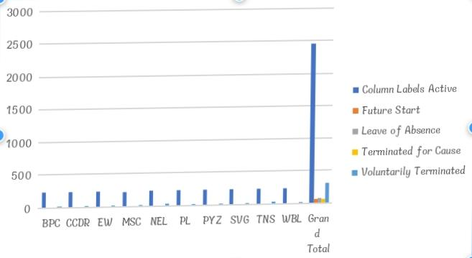
RESULTS
11

Slide 12
conclusion
Our employee performance analysis using Excel provides actionable insights to enhance talent development and drive business success. By leveraging Excel’s capabilities, organizations can make data-driven decisions to improve workforce productivity and performance.

